Slide 1


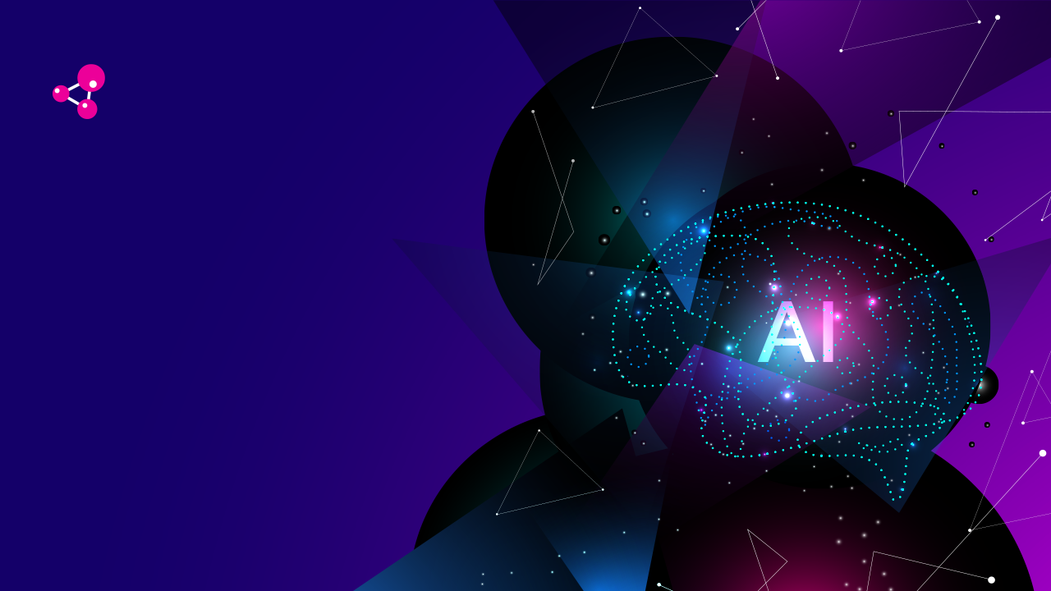
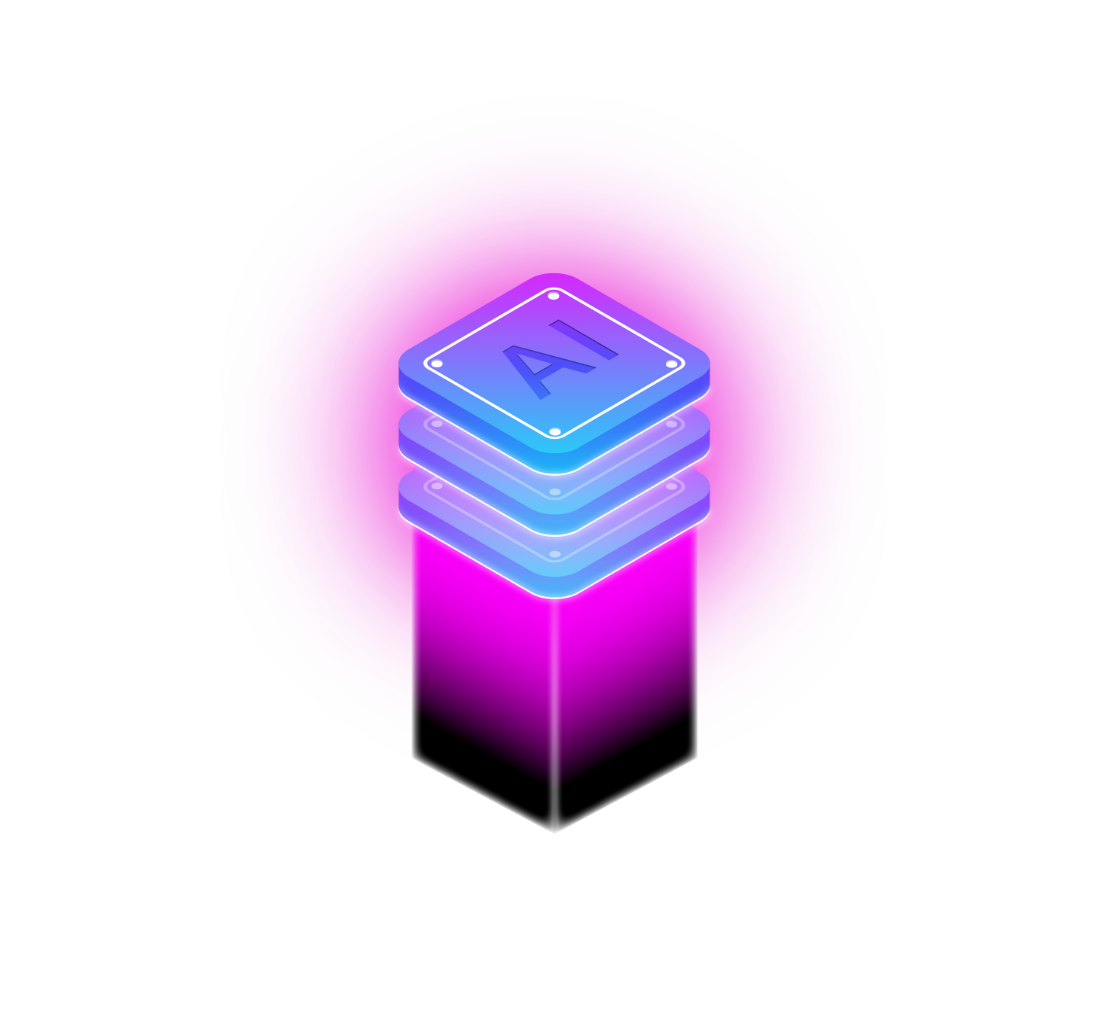
Content
Instructor: Nguyen Thanh Tuan
ARTIFICIAL INTELLIGENCE
CHATBOT
Team: Uyen, Hung, Trung

Slide 2
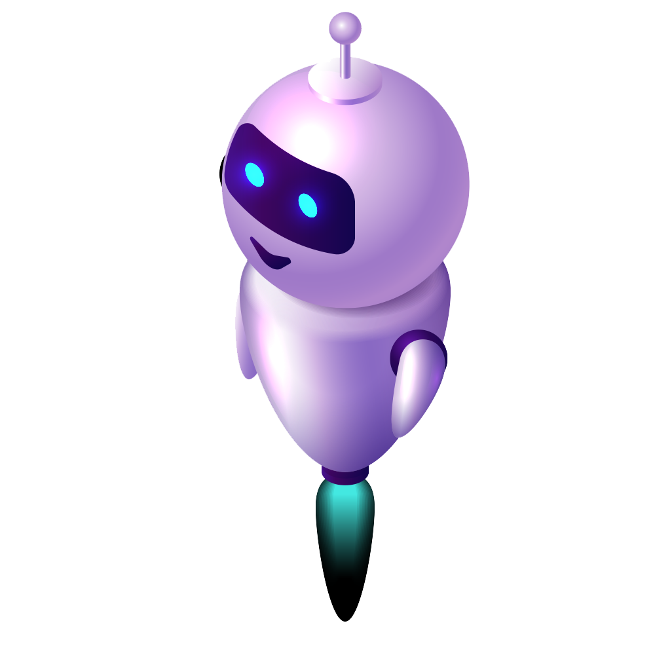

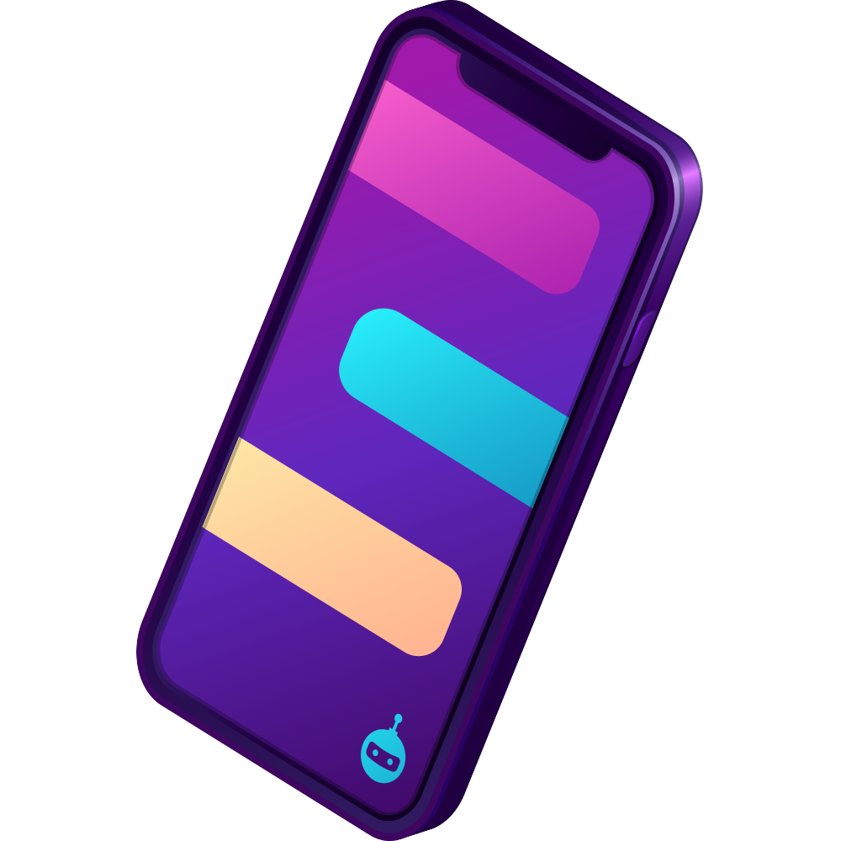
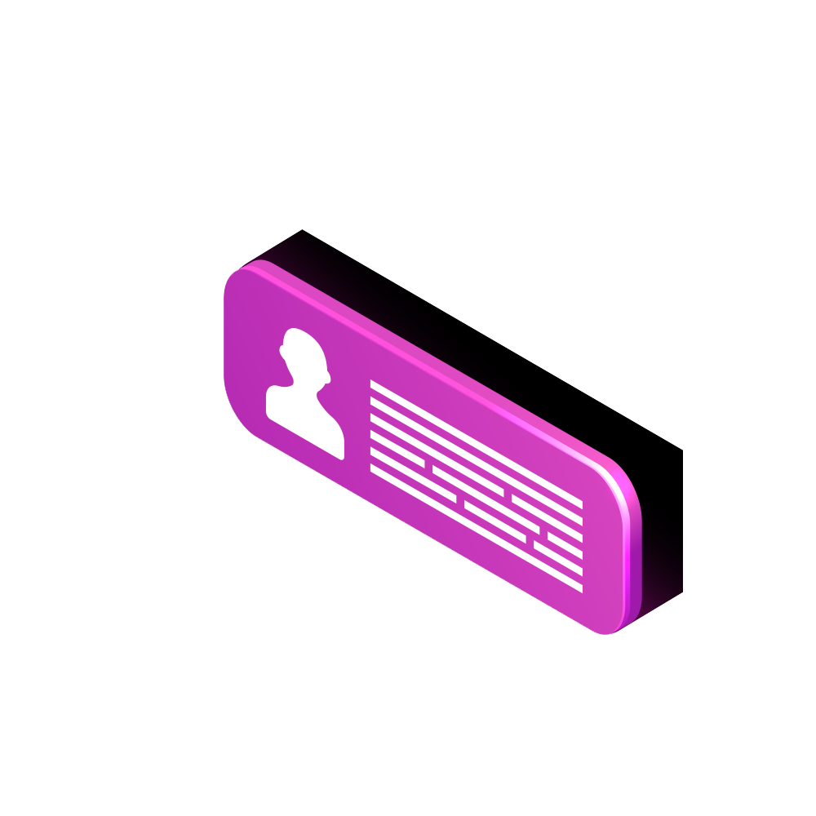

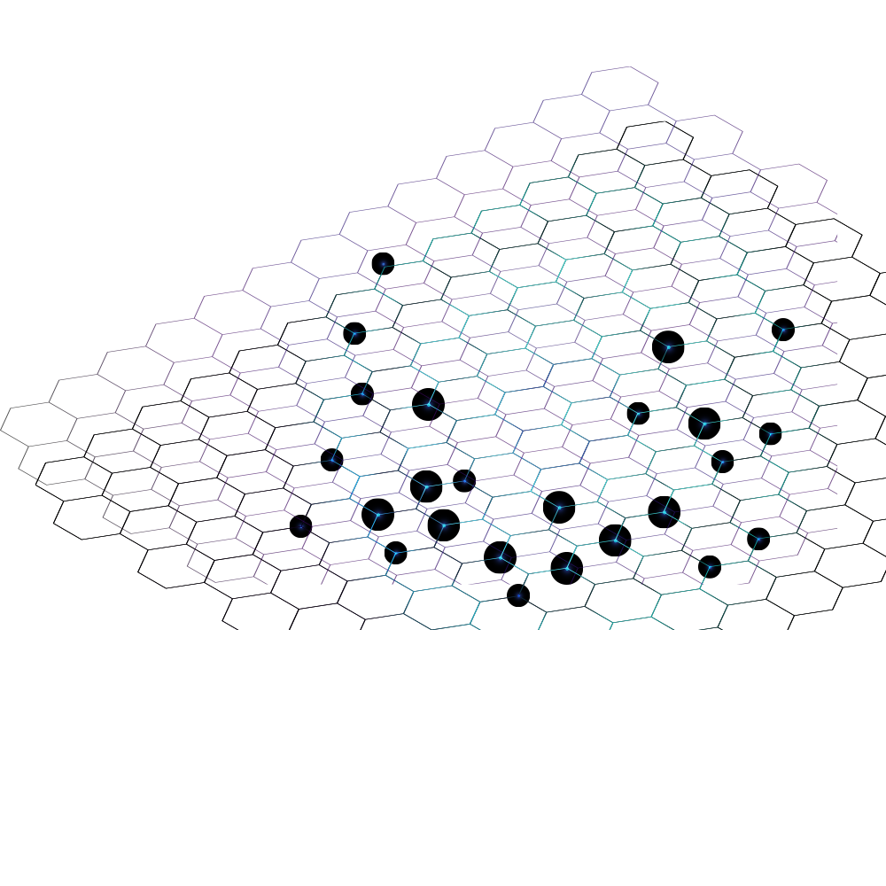
What is chatbot?
Content
ARTIFICIAL INTELLIGENCE
CHATBOT
01
Chatbot
02
RASA Platform
03
Dual Intent and Entity Transformer (DIET)

Slide 3


How chatbot works?
What is chatbot?
Content
A computer program that simulates and processes human conversation
Allowing humans to interact with digital devices as if they were communicating with a real person
Rudimentary programs that answer a simple query
Digital assistants that learn and evolve to increase levels of personalization as they gather and process information

Slide 4
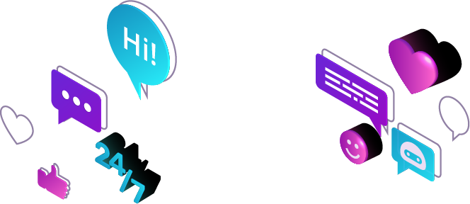
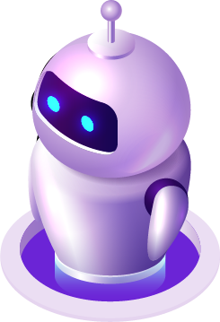

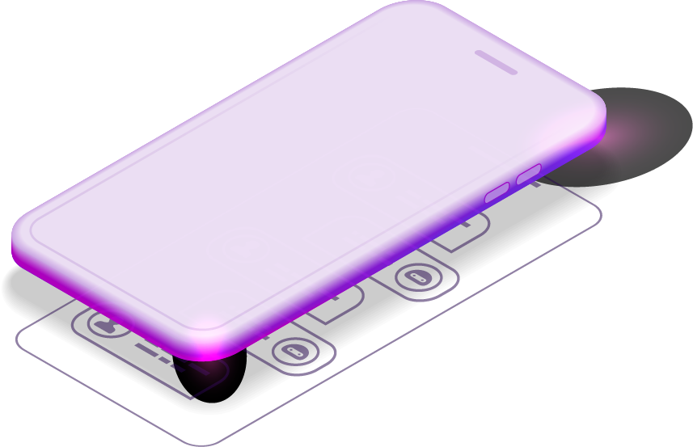

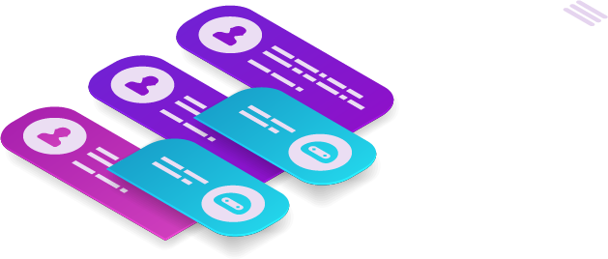


Natural Language Understanding
What is chatbot?
How chatbot works?
Working by analyzing and identifying the intent of the user’s request to extract relevant entities
Working by adopting three classification methods
Pattern matching
Natural language understanding (NLU)
Natural language processing (NLP)

Slide 5






Natural Language Processing
How chatbot works?
Natural Language Understanding
Delivery reception
Param
Action
Context
Control home device
Param
Action
User
Bot instance
Messenger
Bot - express
Skill
Entities: present an idea to your chatbot
NLU
Expectations: Bot must be able to make a request or ask a query
Context: when NLU algorithm identifies the request and it has no historical backdrop of conversation -> not able to recall the request to give the response

Slide 6

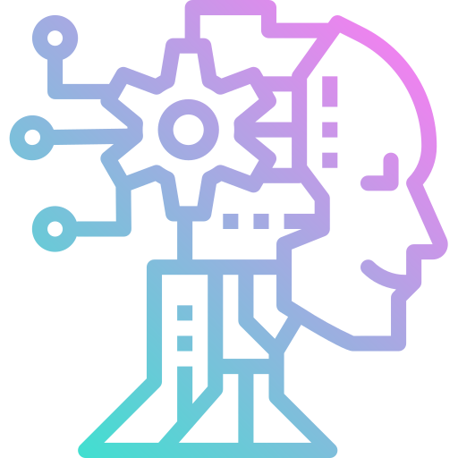


Messenger
Types of Chatbot
Delivery reception
Natural Language Understanding
Natural Language Processing
Param
Action
Knowledge Base
(Source Content)
Context
Data Storage
Control home device
NLP Layer
(Natural Language Processing)
(Interaction History and Analytics)
Tokenization: The NLP filters set of words in the form of tokens
User
Param
Action
Sentiment Analysis: the bot interprets the user responses
Nomalization: check typo errors that can alter the meaning of the user query
Entity recognition: look for different categories of information required
Dependency Parsing: searches for common phrases that what users want to convey
NLU

Slide 7
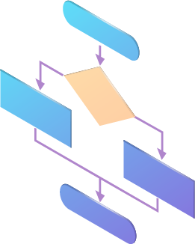

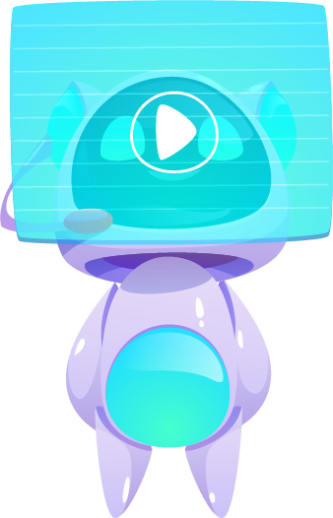
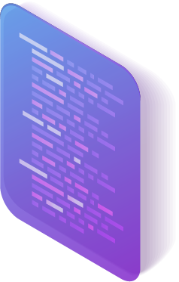

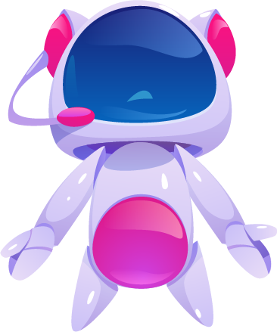
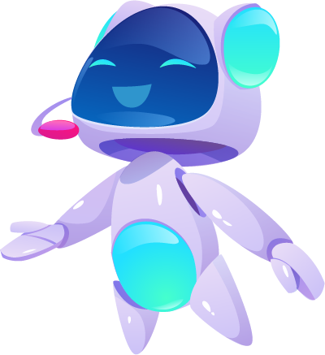


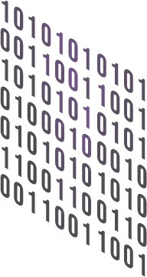
NLP Layer
(Natural Language Processing)
Why you need Chatbots?
Natural Language Processing
Types of Chatbot
Knowledge Base
If-then Chatbot
Rule based Chatbot
Conversational Chatbot
(Source Content)
Data Storage
(Interaction History and Analytics)

Slide 8

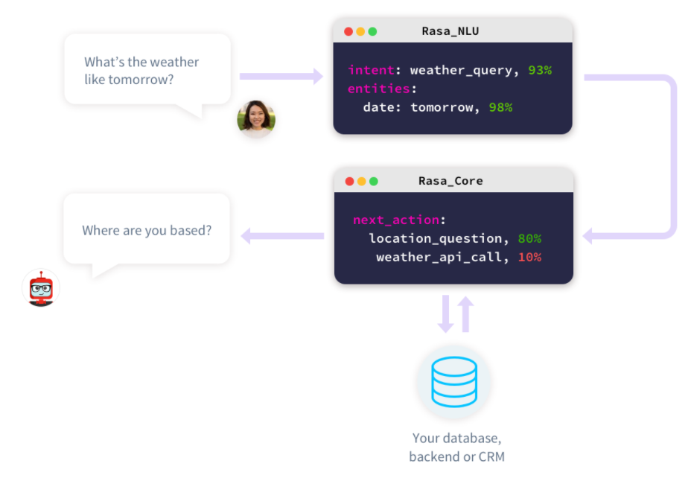
RASA
Types of Chatbot
Why you need Chatbots?
Reduce customer waiting time
Better customer engagement
Easy scalability with bots
Save customer service cost
Reduce customer churn rate

Slide 9

RASA NLU
Why you need Chatbots?
RASA
Rasa NLU: alayzing the information that is include in message sent to chatbot by human
Rasa core: predict next action that the bot need to respond to user
Rasa X: interface of rasa

Slide 10
RASA
RASA NLU
I want to play ping pong
Pretrained
Entities: Game = “ping pong”
Intent: Play Game
BERT/ConveRT/GloVe
DIET

Slide 11
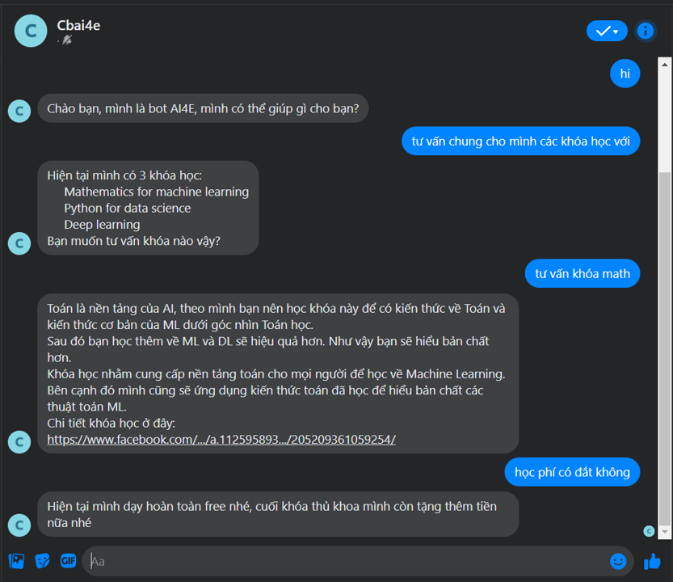



CHATBOT ON FACEBOOK MESSENGER
RASA NLU
Entity Loss
Total Loss
Mask Loss
Entity = O
Entity: game_name
Entity: game_name
CRF
Embedding Layer
Intent Loss
Similarity
Embedding Layer
Transformer (2 layers)
Similarity
Embedding Layer
Feed- Forward
Feed- Forward
Feed- Forward
Feed- Forward
Feed- Forward
Embedding Layer
Feed- Forward
Feed- Forward
Pretrained embedding
Feed- Forward
Pretrained embedding
Feed- Forward
Pretrained embedding
Feed- Forward
Pretrained embedding
Sparse Features
Sparse Features
Sparse Features
Sparse Features
play
ping
_MASK_
_CLS_
Intent: play_game
pong

Slide 12
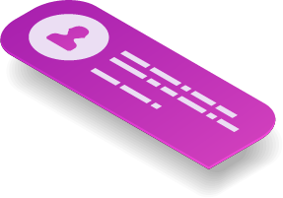


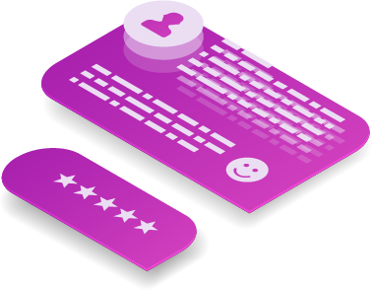
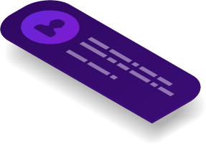

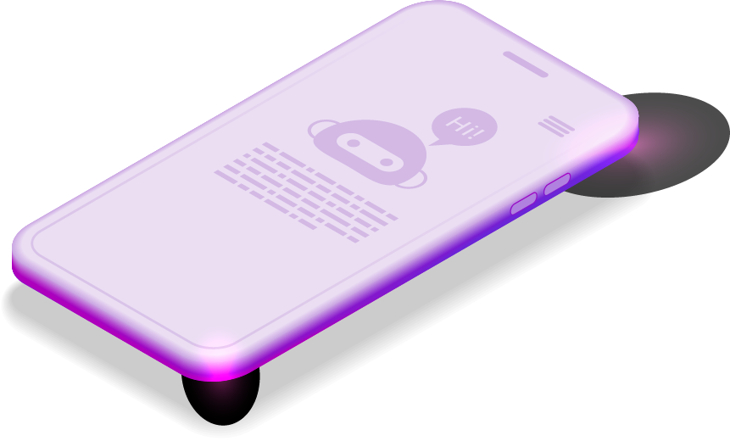


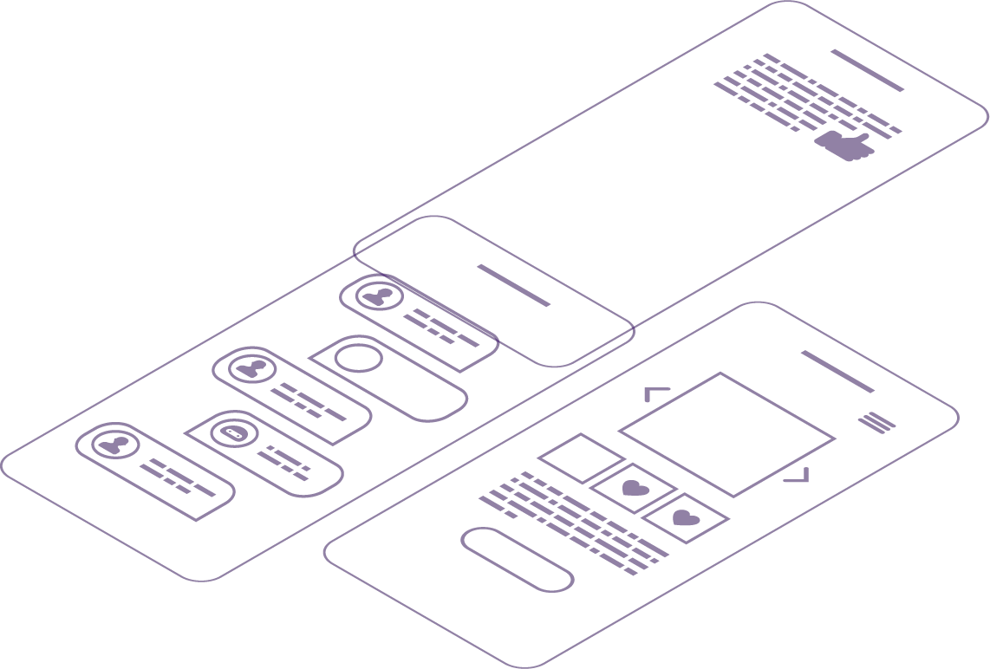
THANK YOU
CHATBOT ON FACEBOOK MESSENGER
FOR
LISTENING

Slide 13
CHATBOT ON FACEBOOK MESSENGER
THANK YOU
FOR
LISTENING

